Slide 1
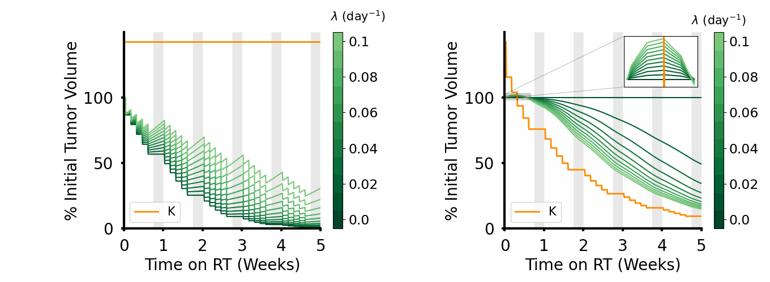



Slide 2
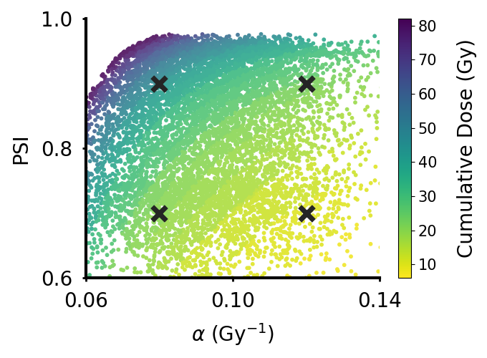
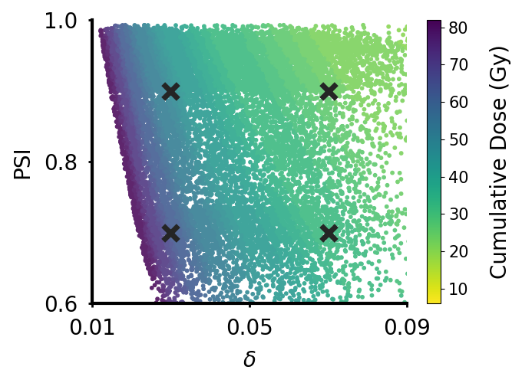

Slide 3
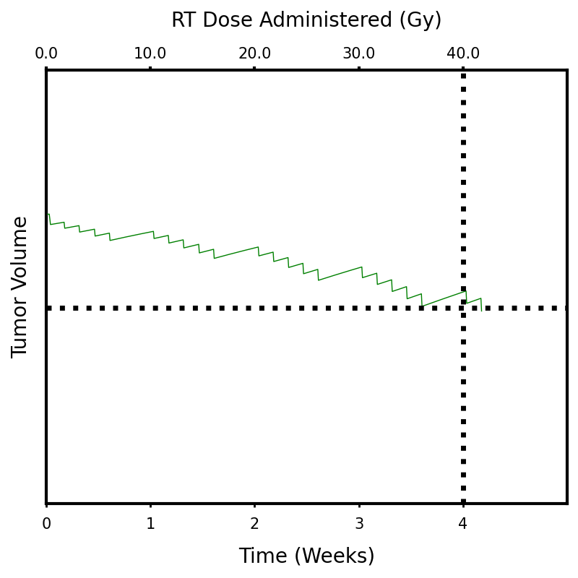
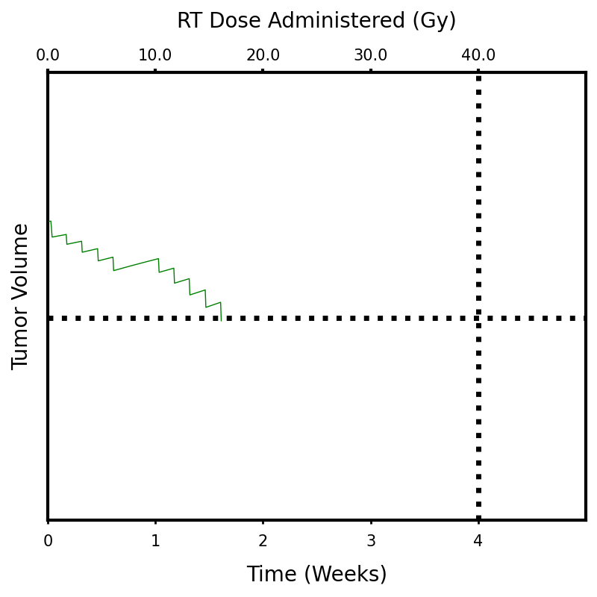
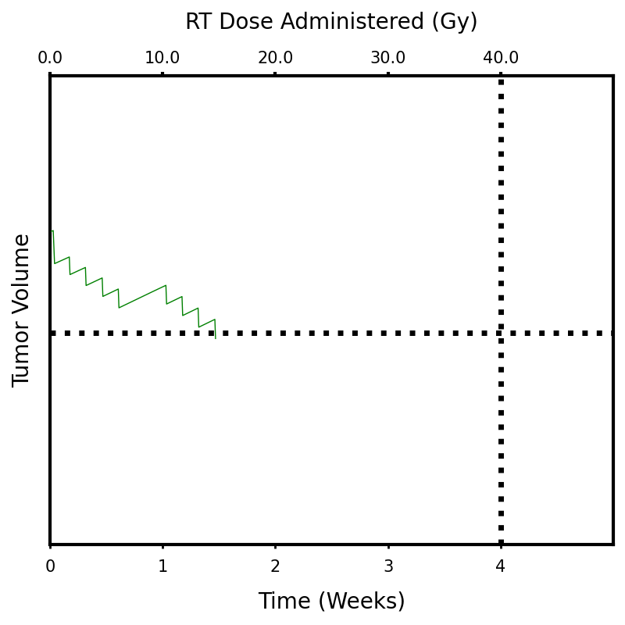
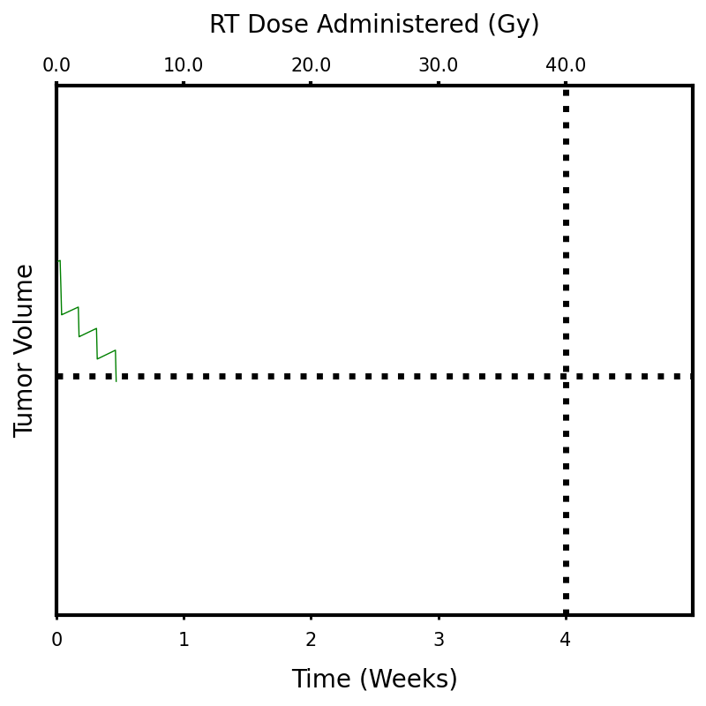
Direct
α = 0.08, PSI = 0.9
α = 0.12, PSI = 0.9
α = 0.08, PSI = 0.7
α = 0.12, PSI = 0.7

Slide 4
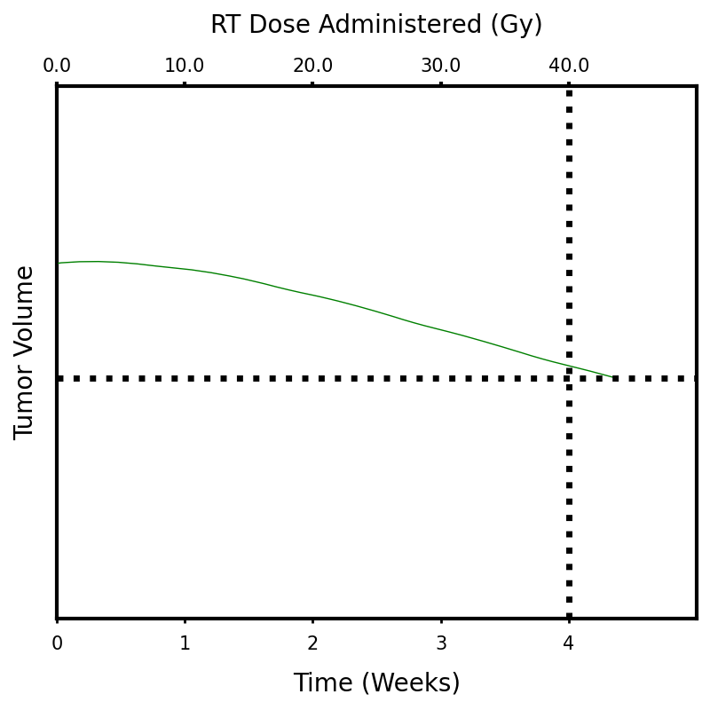
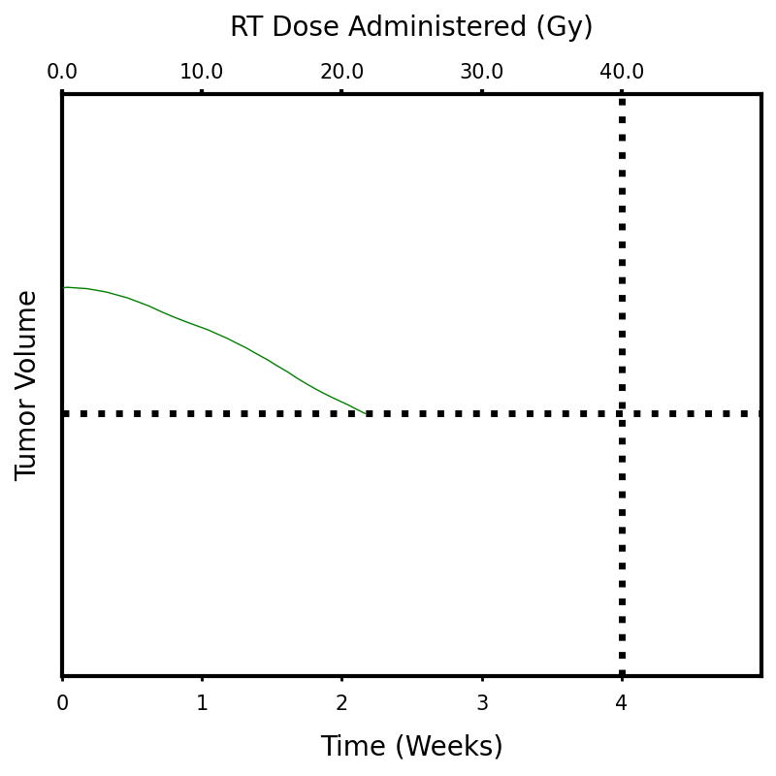
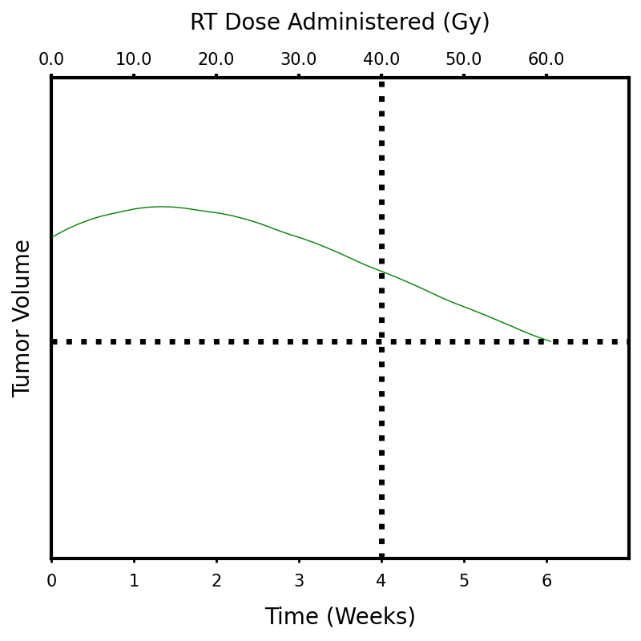
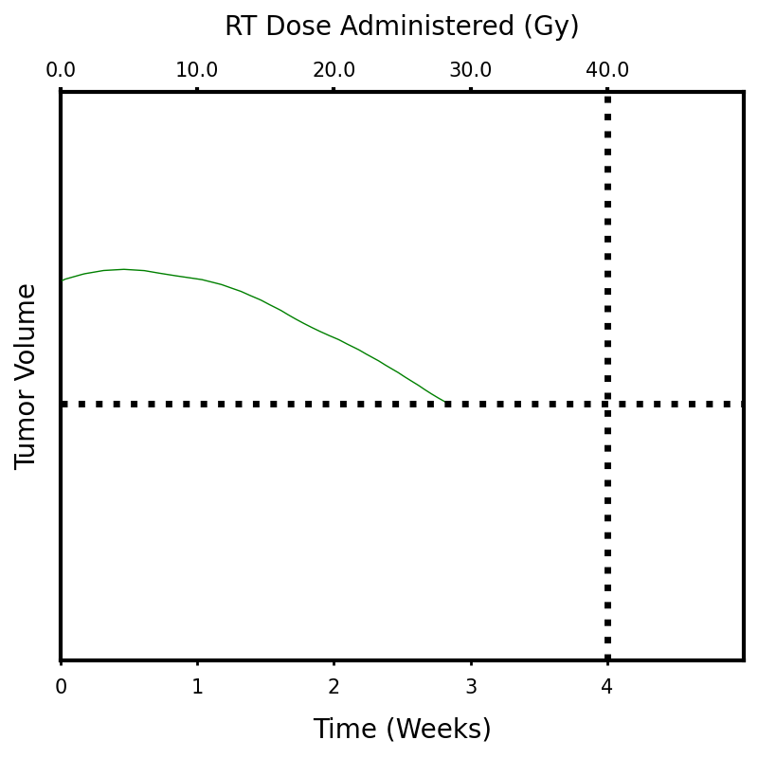
Indirect
δ = 0.03, PSI = 0.9
δ = 0.07, PSI = 0.9
δ = 0.03, PSI = 0.7
δ = 0.07, PSI = 0.7

